Slide 1

eHeart – A Digital Platform for Spiritual Care in Denmark
Presentation at the conference on digital spiritual care "Digital Spiritual Care – quo vadis?"
September 14, 2023
By Maiken Langhoff Kidholm, Laura Kvorning & Ricko Damberg Nissen from the Research Unit of General Practice, University of Southern Denmark

Slide 2

Description of the project eHeart
The project is a clinical innovation project to develop, test and implement an eHealth solution (called eHeart) to improve coping with existential needs of patients and their informal caregivers (family and close relations) affected by severe illness.
eHeart will ease and supplement the healthcare professionals’ existential care as part of person-centered care.

Slide 3
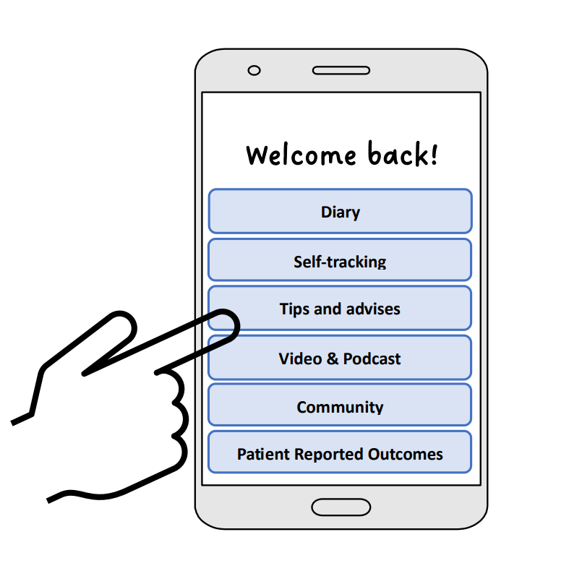
What is eHeart?
It will be a mobile app (integrated in an existing public eHealth platform), including self-assessment tools, educational materials, coping strategies, and self-reflection exercises.
eHeart will support the patients and caregivers to meet their existential needs (e.g. identity, meaning and purpose of life and associated thoughts and feelings)

Slide 4

A sustainable eHealth solution
eHeart is a sustainable eHealth solution as it is
developed through a user-centered and participatory approach to meet the needs of the users
integrated into the existing patient platform ‘Mit Sygehus’ provided by our hospitals in the Region of Southern Denmark.
accessible independently of healthcare professionals’ availability and competencies.
possible to use throughout the illness trajectory from the time of diagnosis and as long as they need it
tailored to each patient’s unique needs using Artificial Intelligence (AI)
possible to be private or share information with healthcare professional if desired.

Slide 5

Target Group
eHeart is for adults (18+) diagnosed with a cancer diagnosis and their relatives.
eHeart will support the healthcare professionals in the assessment of and caring for existential needs to supplement the care for their patients.

Slide 6
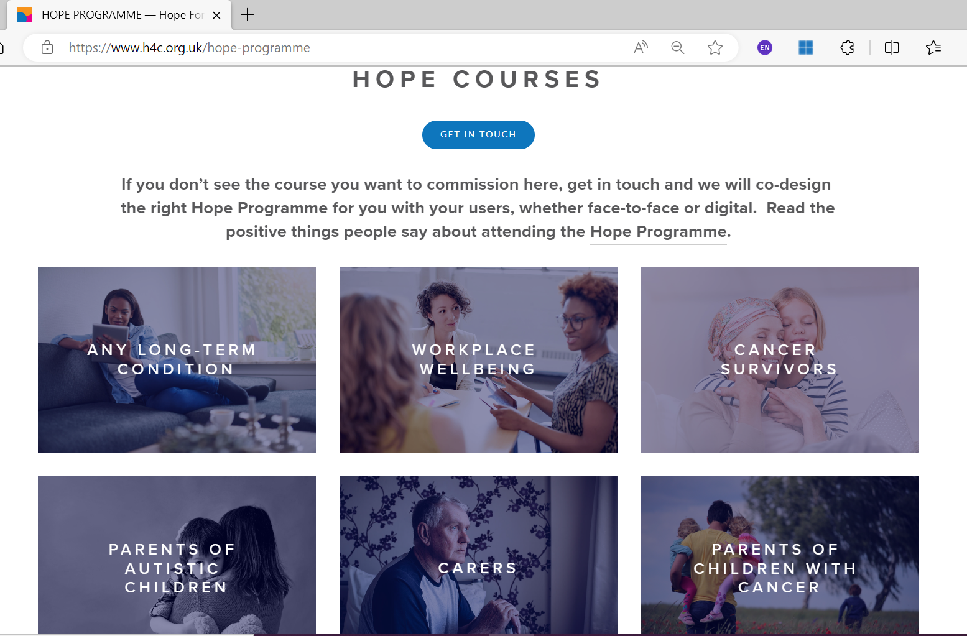
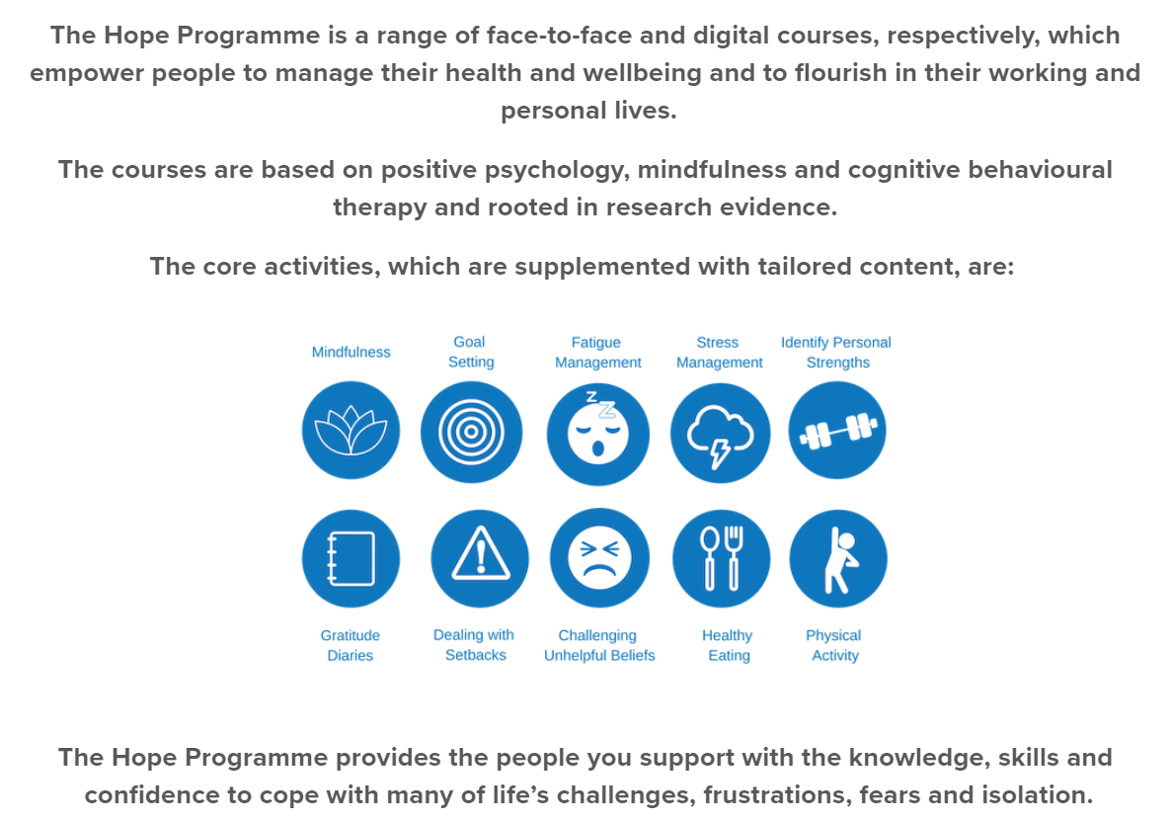
Inspiration from the platform Hope for the community from UK
OUR MISSION
To provide affordable, co-created, evidence-based products and services to empower people to manage their health and wellbeing.

Slide 7
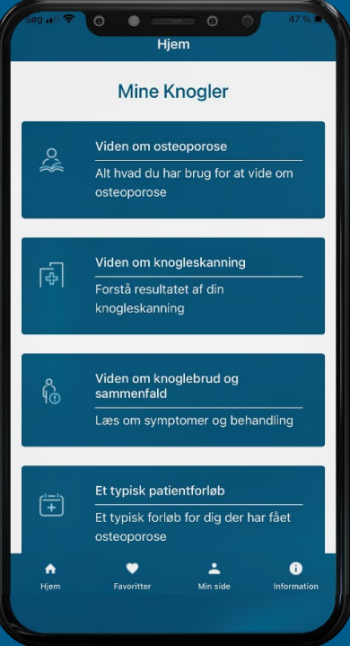
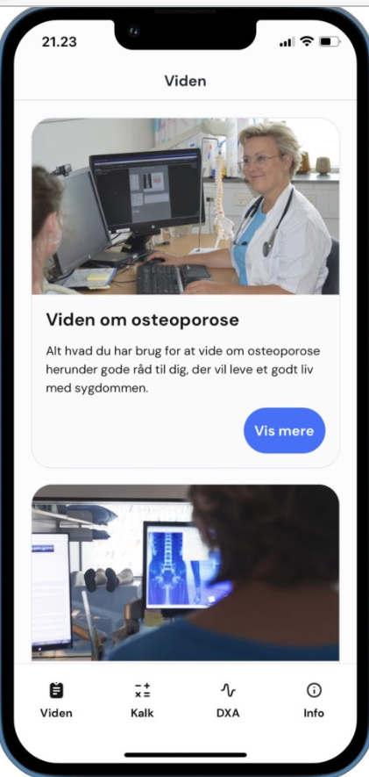
Inspiration from Danish eHealth app My Bones
The app "My bones" can help you better cope with your osteoporosis. Partly by to give you knowledge about the disease and partly by giving you concrete tools that you can use to manage your illness in everyday life. There are suggestions for bone-friendly training, with exercises targeted at different stages of the disease.

Slide 8
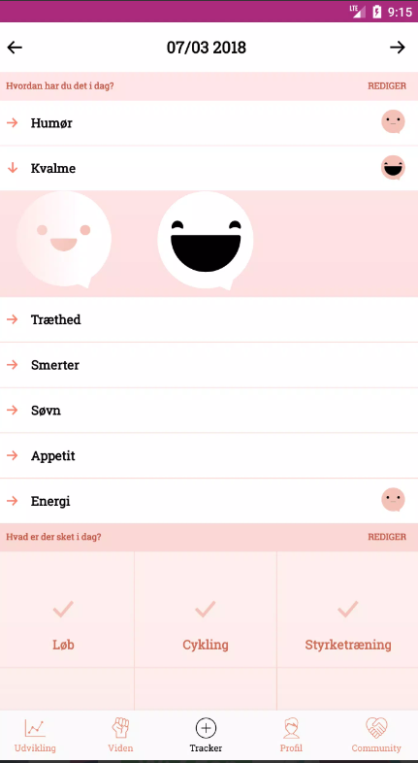
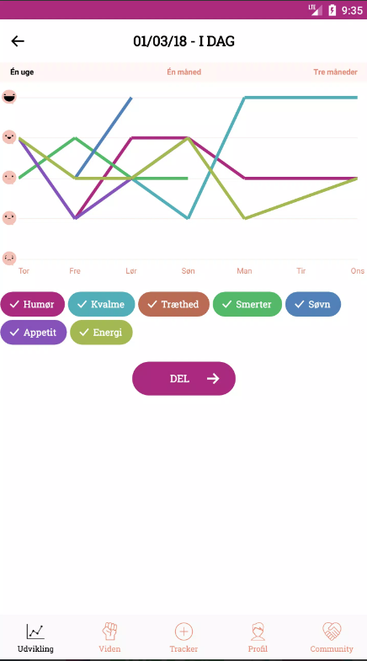
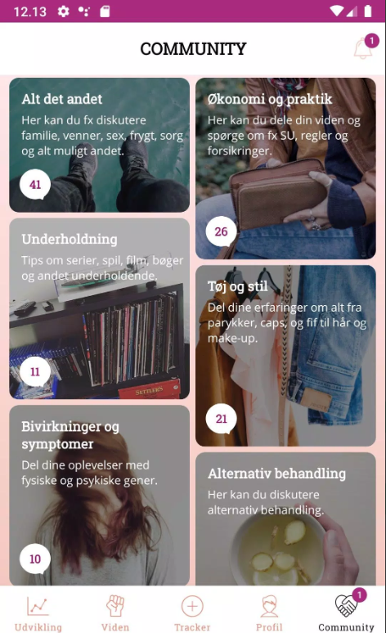
Inspiration from the Danish eHealth app Kræftværket – an app to increase the quality of life for young cancer patients during and after treatment.

Slide 9
Feedback from patients and relatives
Nice to focus on the existential - that's missing!
An app cannot solve the problem – but start something for someone (create a language) – others will not be caught
Some are digitally frightened – it's a form of terror
There is a difference between the patient and the relatives
- Patients need it (existential and spiritual) in small doses
Relatives want to have it (existential and spiritual) all at once
An app could well function as a third party to facilitate conversation about the existential and spiritual
Good to have an app that is easily accessible.
Notes:
Nice to focus on the existential - that's missing!
Attention to collaboration with other actors – priest, palliative care team, if possible.
Good to have an app that is easily accessible.
An app cannot solve the problem – but start something for someone (create a language) – others will not be caught
Good that we will uncover the need first
An app could well function as a third party to facilitate conversation about the existential and spiritual
Investigate when in the process it is most relevant to use an app
If there was content in the app for all the different phases you go through, that would be good.
Before the interview, consider who to invite. The existential and spiritual can fill in differently at different times and you have to be able to talk about it. Perhaps it was a good idea to include very broadly, so that it was the patient/relatives themselves who made the decision as to whether it was relevant for them
There is a difference between the present and the relatives
Patients need it (existential and spiritual) in doses
Relatives have it (existential and spiritual) whole at once
The app must spread to the departments that refer to oncology/haematology.
Use AI so that content is adapted
Some are digitally frightened – it's a form of terror
Important to create a space where you can talk about this
The difficult talk – the deep reflections many need help with – but don't stand alone

Slide 10




What is the project plan of eHeart?
1. Identification of needs
Recruiting patients, caregivers and health professionals for interviews and focus group discussion to conduct a needs assessment.
2. Design and development
User involvement process for the development of a prototype of eHeart in cocreation with patients, caregivers, healthcare professionals, researchers and IT experts.
3. Test and evaluation
Pilot study testing the prototype by patients, caregivers and health professionals for 6 months. The evaluation of the pilot study include the user experience, feasibility and the output and outcome of eHeart based on a mixed-method research design. Based on the results of the evaluation, adjustments are made in the prototype.
4. Implementation
Introduction and use of eHeart by health professionals and patients at Odense University Hospital. Then implementation at remaining hospitals in the Region of Southern Denmark and n the other regions of Denmark.

Slide 11

Participatory design process
In this project, the method used is participatory and based on Design Thinking to ensure a creative and digital process. The method ensures that the target group's needs are at the center throughout the process, including
analyses of the user context
co-creation workshops with all the target groups, relevant stakeholders, and the project team
mapping the user journey and outline desired user experience
testing and evaluating the user-friendliness and satisfaction, including that the platform is intuitive and easy to use for the target groups
This will be done through various participatory methods; interviews, workshops, and focus groups.

Slide 12
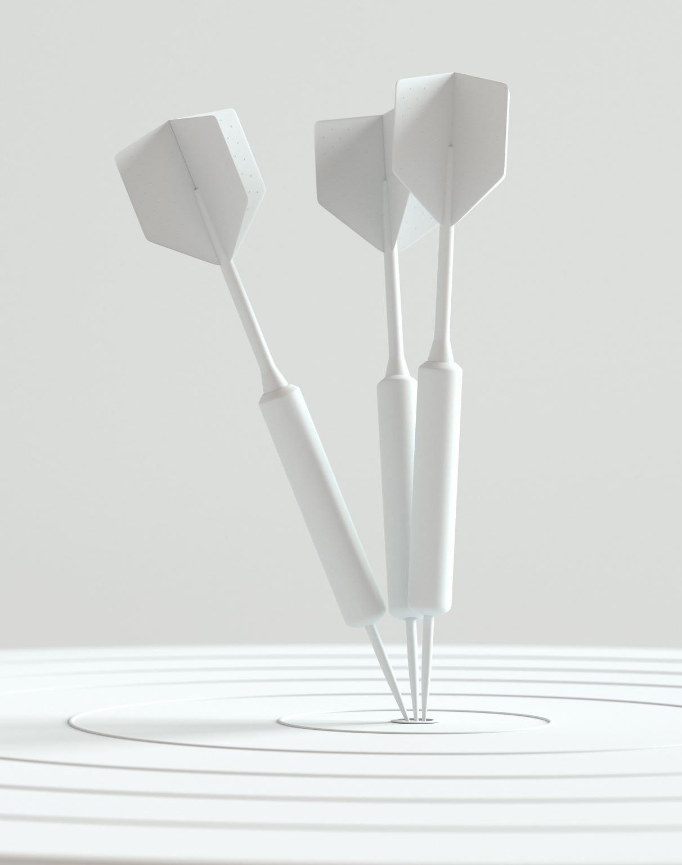
The desired clinical impact
Minimum 10% of the patients and their caregivers
  use eHeart and find it relevant
  score the user satisfaction high og very high.
  It can be influenced by many factors, such as usability, functionality, design, performance, support, and value and these factors will be explored via qualitative methods.
  score the user experience high or very high
  will recommend eHeart to others
Minimum 40% of the healthcare professionals offer eHeart to their patients and see eHeart as a relevant and usable to supplement the care they can provide at the hospital to meet the needs of the patients and their caregivers.
To what extent the healthcare professionals will have greater job satisfaction and commitment to their work providing eHeart as part of their care, we will explore via qualitative methods.

Slide 13
Contact information:
Maiken Langhoff Kidholm, mlkidholm@health.sdu.dk
Laura Kvorning, lkvorning@health.sdu.dk
Ricko Damberg Nissen, rnissen@health.sdu.dk
Research Unit of General Practice
University of Southern Denmark https://www.sdu.dk/en/forskning/almenpraksis

